Slide 1
Autodesk Vault Workgroup | Professional | Office
Data Standard – Code Samples
Markus Koechl
Solutions Engineer PDM|PLM – Autodesk Central Europe

Slide 2
Content
Configuration Samples
Download Links – VDS Quickstart 2019 Master | OTX2019Config
Consuming Snippets | Extensions | Resources
Query Group Membership
Query Scheduled Jobs | Submit Scheduled Sync Job to Job Queue Now!
Menu Commands | Include Multilanguage Dictionary
Search!
iLogic-Vault Library
Insert Inventor Component as Copy
3rd Column for DSDynCatPropGrid Control
Cascading Custom Object Selection
Edit / Update Item Data Sheet

Slide 3
Configuration Sample
VDS Quickstart 2019

Slide 4
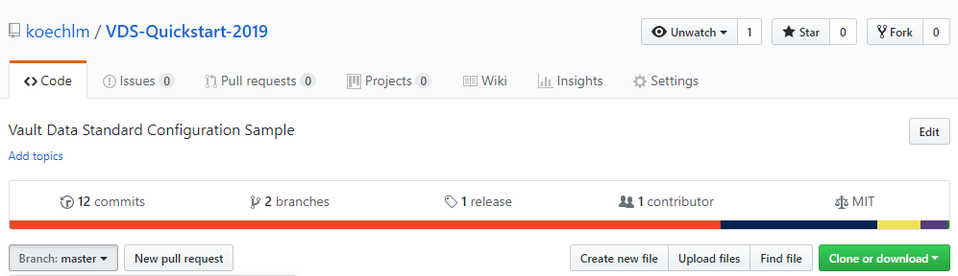
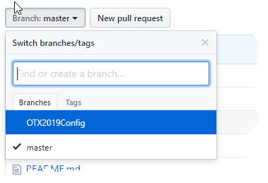
VDS Quickstart 2019
Available @GitHub
https://github.com/koechlm/VDS-Quickstart-2019
Current Branches
Master https://github.com/koechlm/VDS-Quickstart-2019/tree/master
VDS 2018 migrated 2019
OTX2019Config https://github.com/koechlm/VDS-Quickstart-2019/tree/OTX2019Config
VDS QS 2019 incl. What’s New Enhancements + Use Cases

Slide 5
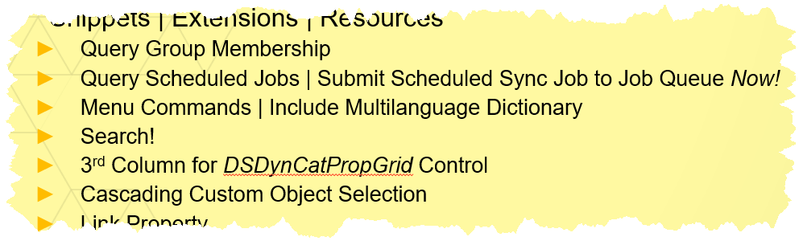
VDS Quickstart 2019 | OTX2019Config
Includes
VDS QS 2019 incl. What’s New Enhancements + Use Cases
Single context for…
Extended FDU Support

Slide 6
Snippets | Extensions | Resources

Slide 7
Query Group Membership | 2018 and before
Task
Check the current user’s group membership
Solution
Create “Dummy” files ACL for each user group
Check current users access to the group - file
Requirements
Vault 2018 and before
“Dummy files” for each group, e.g. “Engineering 2.txt”

Slide 8
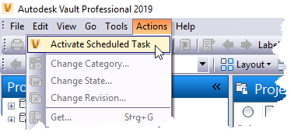
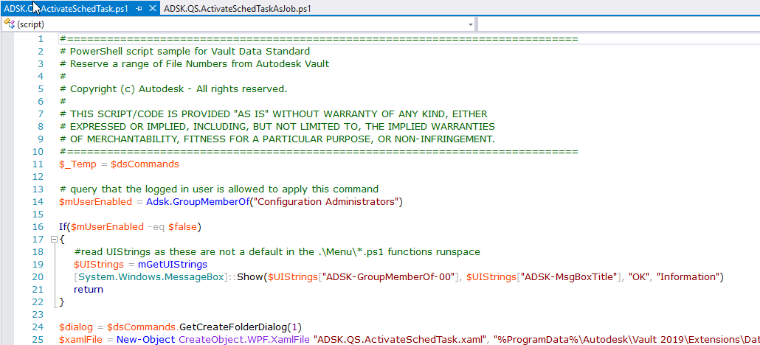
Query Group Membership | 2019 and later
VDS.QS.2019.OTXConfig
Task
Check the current user’s group membership
Solution
Query GroupInfo Object
Requirements
Vault 2019 or later
Create Custom Role with system role “AdminUserRead” assigned
Create User Group “Group Reader” consuming the custom role
Solution Sample

Slide 9
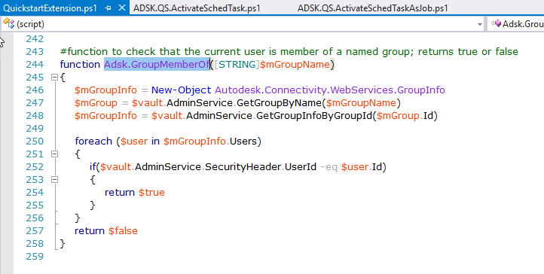
Query Group Membership | Code Details
ADSK.QS.ActivateSchedTask.ps1
QuickstartExtension.ps1

Slide 10
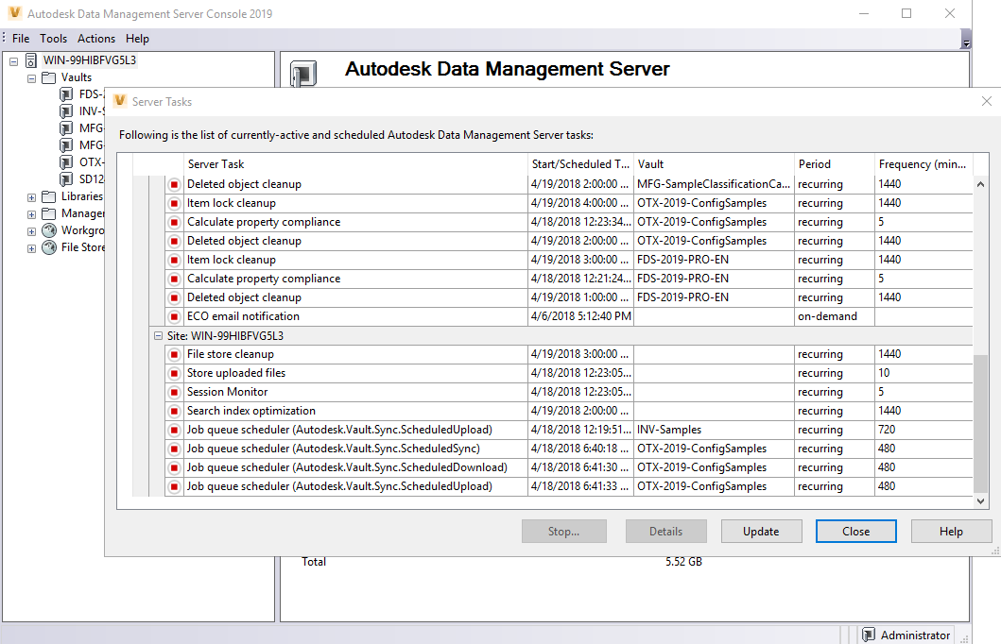
Query Scheduled Job | Submit Scheduled Job
Task
Scheduled Jobs (New in 2019) are Server Tasks – ADMS Console shares the UI
Config. Administrators may require a view on upcoming jobs / execution time
Config. Administrators quickly configure and validate scheduled jobs using options to execute now – independently of the next scheduled execution time
Solution
$vault.JobService.GetScheduledJobs()
Filter Server Tasks (Scheduled Jobs) per Vault
Requirement
Role Configuration Administrator

Slide 11
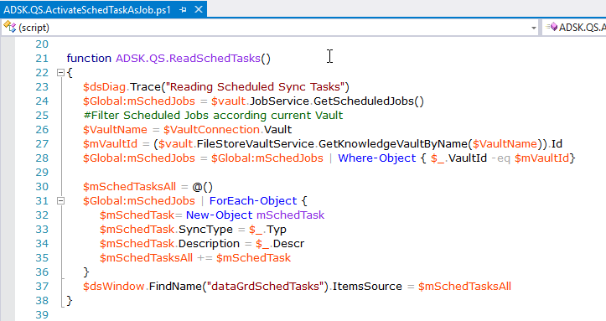
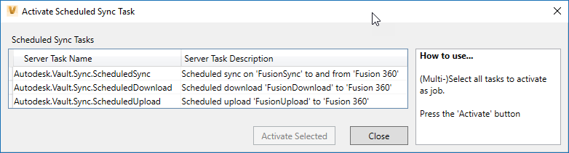
Query Scheduled Job | Submit Scheduled Job
VDS.QS.2019.OTXConfig
Solution Sample

Slide 12
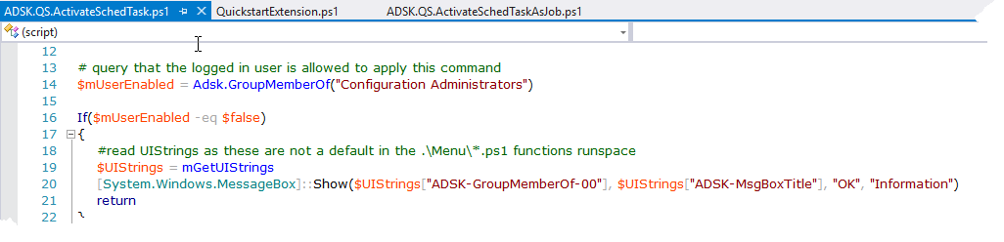
Menu Commands | Include Multilanguage Dictionary
VDS.QS.2019.OTXConfig
Task Issue – Configuration requires Multilanguage Support during menu command initialization
Solution
Script Library – QuickstartExtension.ps1
mGetUIStrings()
Requirements
No dependency
Solution Sample

Slide 13
Search
Task
VDS dialog needs a search result, e.g. Custom Objects by definition, category, and/or other criteria
Issue
Scripting Searches is not as easy... And the options are as manifold, that simplifications ended up in similar complexity
Solution
Library to share functions
Build one to many search conditions, e.g.
[Custom Object Name] = “Term” AND [Title EN] = “Bearing”
Handle the search status with respect of paging, indexing status, max. number results you can manage

Slide 14
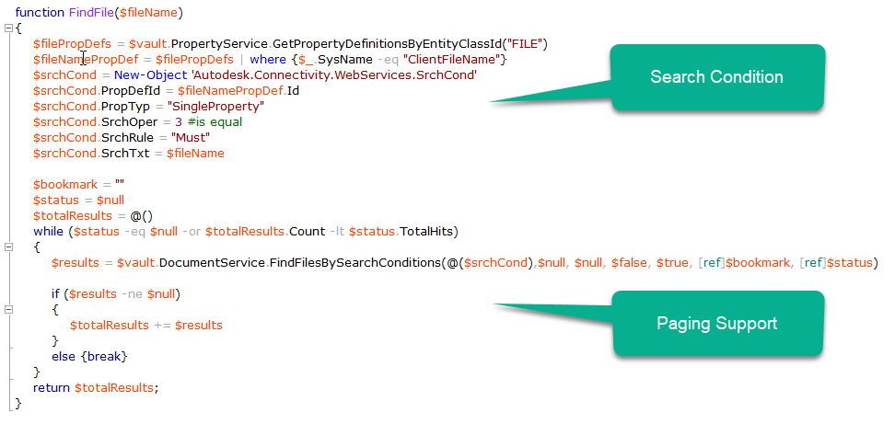
Search | Solution Sample – VDS 2019 Default
Task
Check that file exists @ given location = Enforce Unique File Names Disabled
Check that file exists in entire Vault = Enforce Unique File Names Enabled
Solution
Find file by full path
Find file by single search condition
Update existing search(s) adding
paging support
Tip

Slide 15
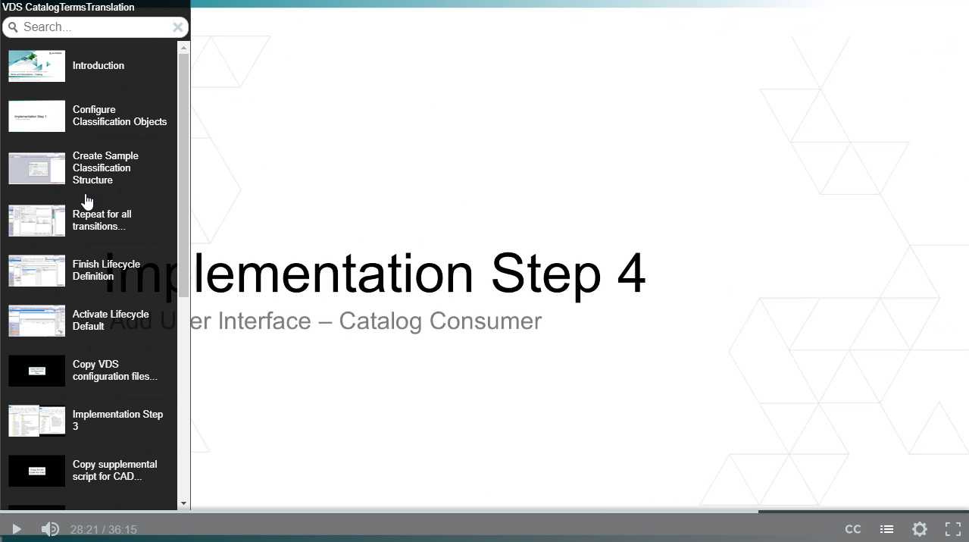
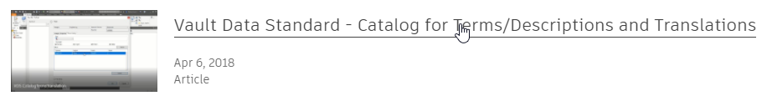
Search | Solution Samples
Updated Catalog of classified Short Descriptions / Terms / Localizations
Uses multiple, but limited number of search conditions based on classification structure
NEW video documentation to configure
Classification
Catalog
New video documentation to integrate VDS configuration in existing custom environments

Slide 16
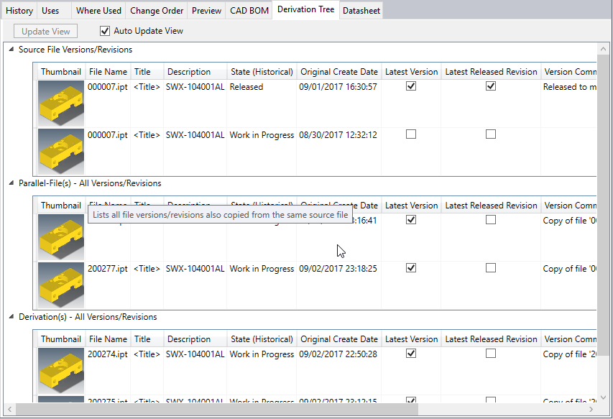
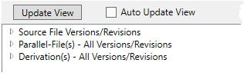
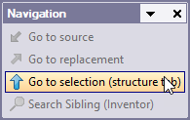
Search | Solution Samples
Derivation Tree - “Multi-Search”
Searches for source files
selected file copied from existing
Searches for siblings
Selected file is not the only copy from existing origin
Searches for subsequent copies
Selected file itself is source for newer copies
Availability
AKN – Release 1.0
OTX2019Config – Release 2.0
Notes:
Release Notes 2.0.
Optimized Search – Paging
Update View/Run searches on demand or auto update as selection changes

Slide 17
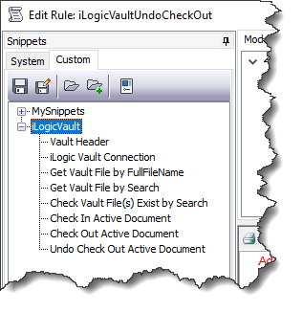
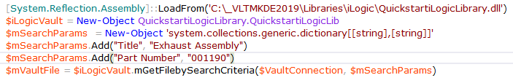
Search | Solution Samples
Inventor iLogic - Vault Library
Consume functions in iLogic Editor
Consume functions in VDS scripts
Get Vault File by … = Download
Check Vault File(s) Exist = Search by one to many property values
Sample VDS Script

Slide 18
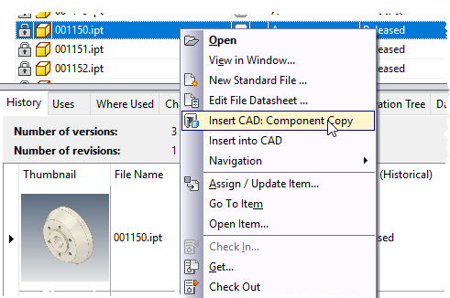
Insert Inventor Component As Copy
VDS.QS.2019.OTXConfig
Task
Selecting Components from Vault Libraries, the inserted part in Inventor is expected as copy applying individual parameters as next step
Solution
Context Menu – Insert CAD: Component Copy
Downloads latest file version – enforce override
Copies applying new file number
Insert into current assembly
Solution Sample – Insert CAD: Copy
Requirements
Inventor iLogic – Vault Quickstart Library
Or
powerVault

Slide 19
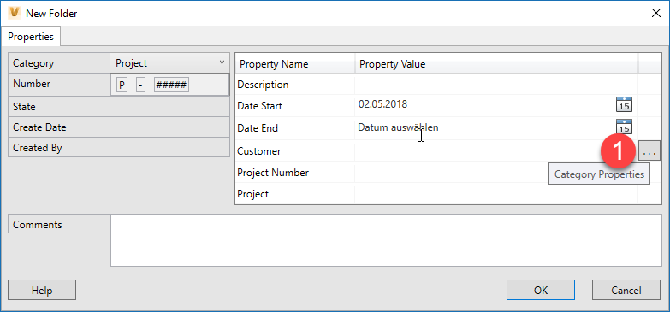
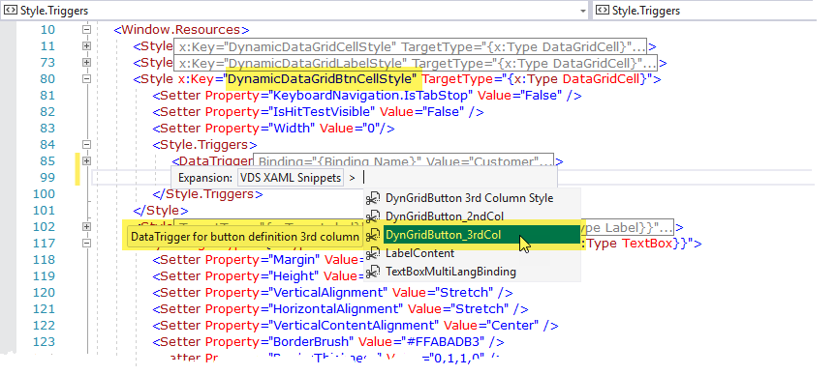
Dynamic Property Grid | 3rd Column
VDS.QS.2019.OTXConfig
Link command to any property
Leverage Style Snippet

Slide 20
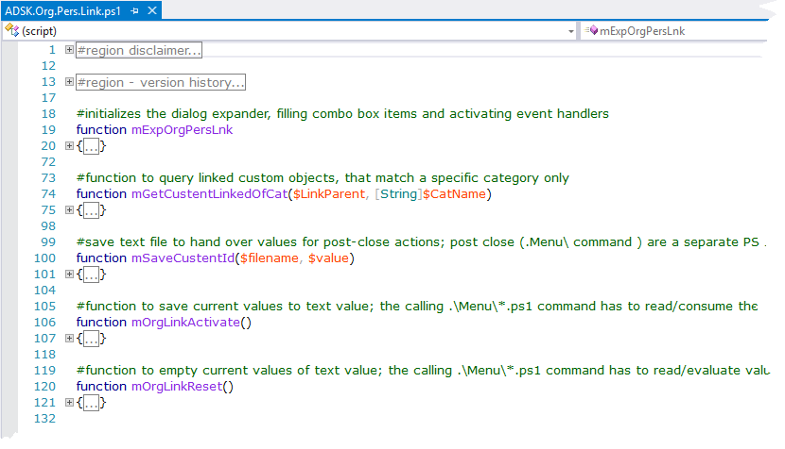
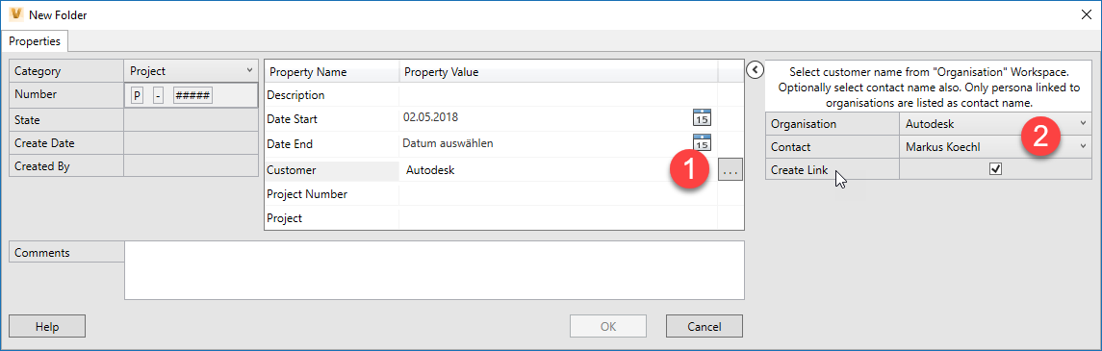
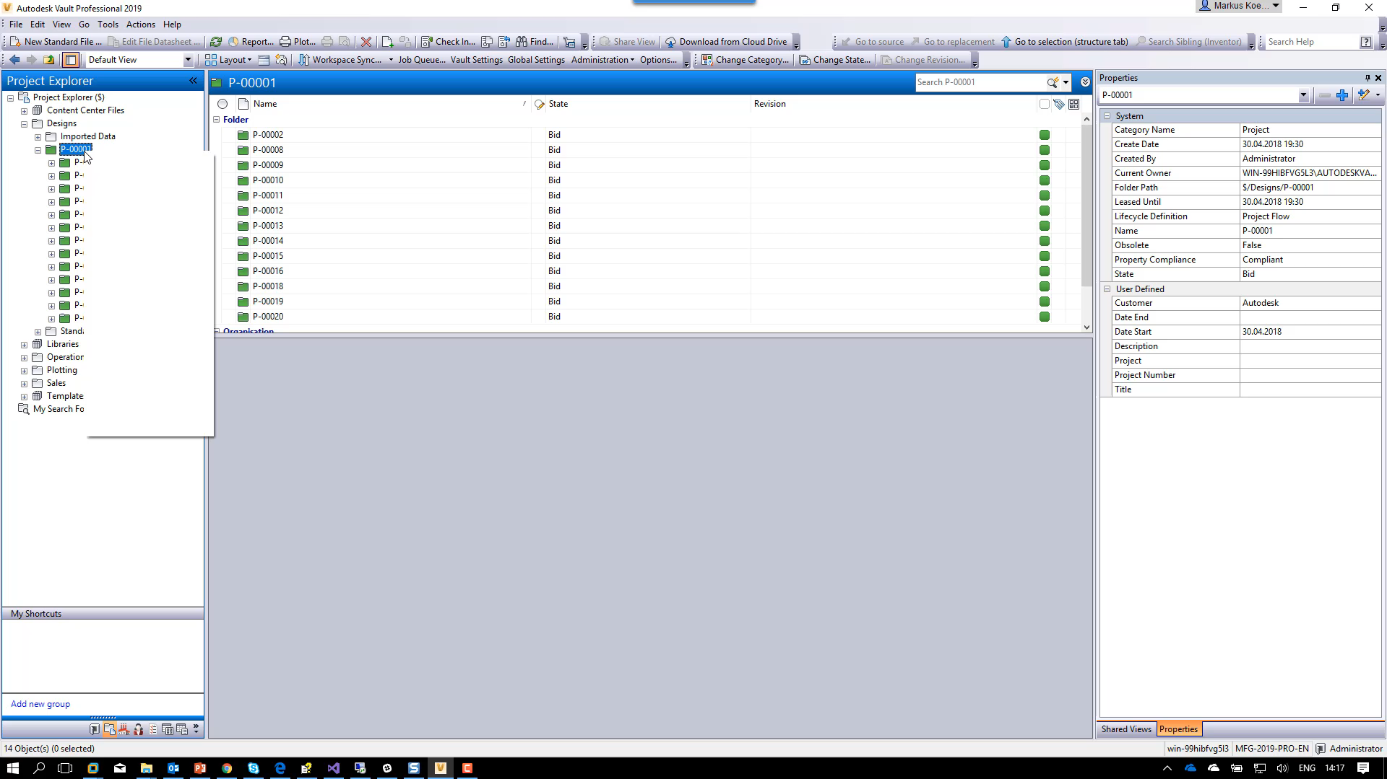
Cascading Custom Object Selection
VDS.QS.2019.OTXConfig
Select Organization/Persona
Add property command (3rd column)
Search Organization
Query Linked Persona/Organization

Slide 21
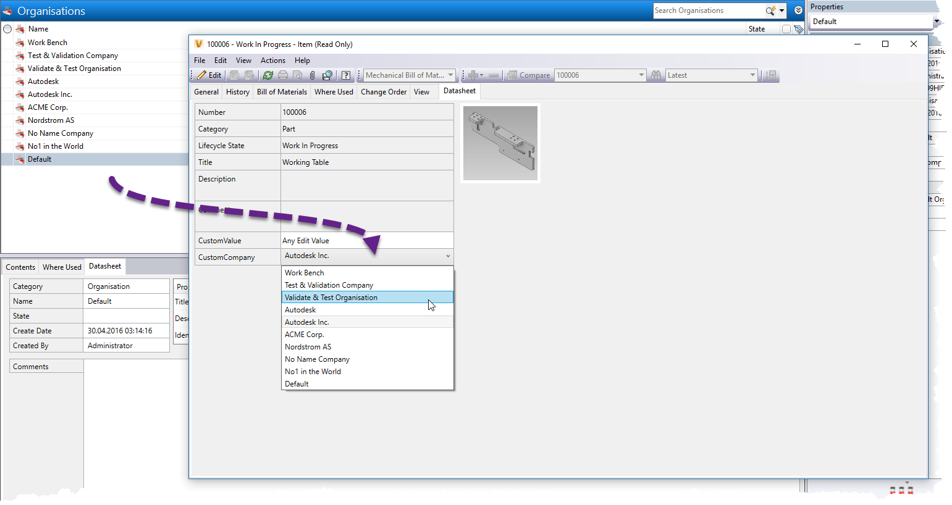
Edit Item | Edit ECO – Technology Preview
VDS.QS.2019.OTXConfig
Task
Select Custom Objects Editing Item or ECO
Apply VDS rules like cascading combo boxes
Solution
Item Edit Tab | ECO Edit Tab
Solution Sample / Preview VDS.QS.2019.OTXConfig

Slide 22
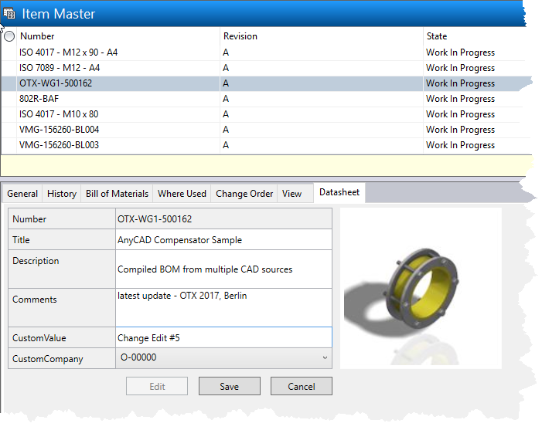
Edit Item | Technology Preview
VDS.QS.2019.OTXConfig
Task
Edit Item and consume VDS logic/rules like cascading combo boxes
Solution
VDS Item Edit Tab
Solution Sample / Preview
Framework of Tab Window and commands/rules

Slide 23
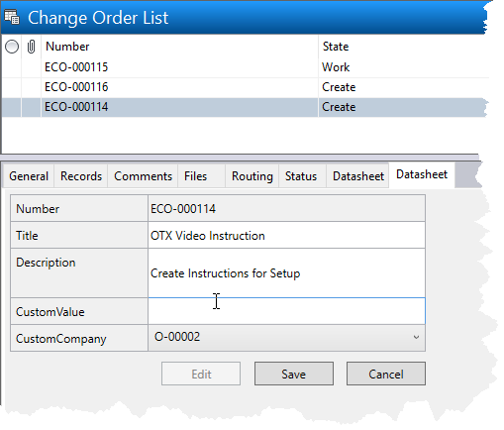
Edit ECO | Technology Preview
VDS.QS.2019.OTXConfig
Task
Edit ECO and consume VDS logic/rules like cascading combo boxes
Solution
VDS ECO Edit Tab
Solution Sample / Preview
Framework of Tab Window and commands/rules
Limitation
A user might start the Edit… window and apply VDS Edit command
Results in Error 109 message – not further impact.

